Slide 1
Module 01: Manage Azure Identities & Governance

Slide 2
Lesson 1 – Working with Azure AD Objects

Slide 3


Manage Azure AD Users and Groups
On-Premise Apps
AUTH
AUTH
Users & Groups
Authentication + Authorization
Local
OAuth
Open ID
SAML
WS-Federation
Cloud
Kerberos
NTLM

Slide 4

Azure AD Concepts
Identity: An object that can get authenticated.
Account: An identity that has data associated with it.
Azure AD Account: An identity created through Azure AD or another Microsoft cloud service, such as Microsoft 365.
Azure Subscription: Used to pay for Azure cloud services.
Azure Tenant/Directory: A dedicated and trusted instance of Azure AD.

Slide 5
Benefits and Features of Azure AD
Single sign-on to any cloud or on-premises web app.
Works with iOS, Mac OS X, Android, and Windows devices.
Protect on-premises web applications with secure remote access.
Easily extend Active Directory to the cloud.
Protect sensitive data and applications.
Reduce costs and enhance security with self-service capabilities.

Slide 6
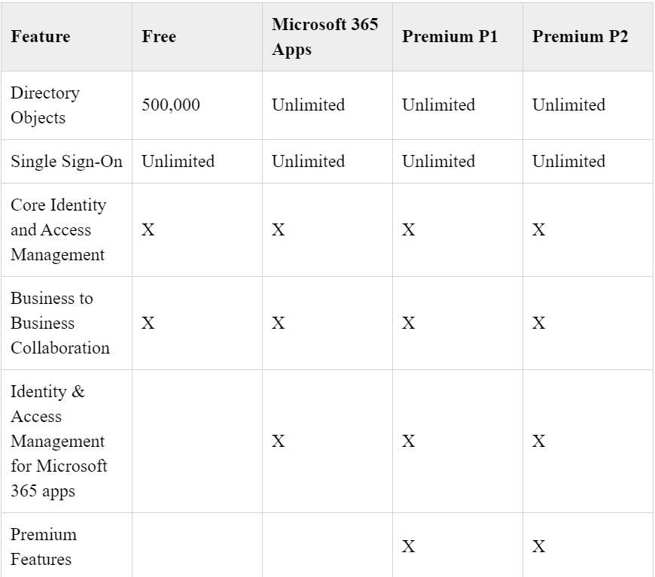
Azure Active Directory Editions
Azure Active Directory Free
Azure Active Directory Microsoft 365 Apps
Azure Active Directory Premium P1
Azure Active Directory Premium P2

Slide 7
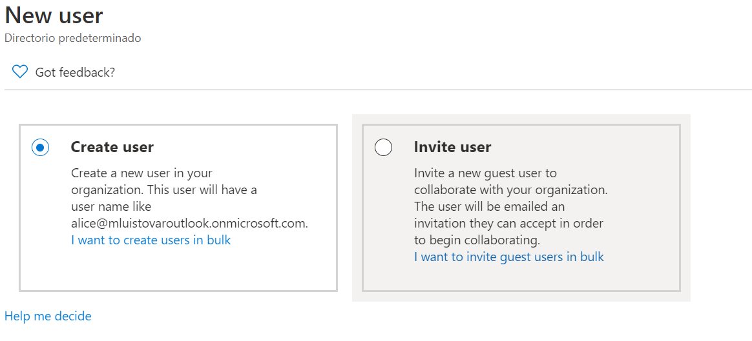
Manage Azure AD Users and Groups
Azure AD defines users in three ways:
Cloud Identities - Users exist only in Azure AD with source on Azure Active Directory or External Azure Active Directory
Directory-Synchronized Identities - Users exist in an on-premises Active Directory.
Guest Users - Users exist outside Azure with source in Invited user. (Examples include Facebook, LinkedIn, Gmail, and Xbox LIVE account)

Slide 8

Creating and Managing Groups and Users
Things to consider when managing users:
Must be a Global Administrator to manage users.
User profile (picture, job, contact info) is optional.
Deleted users can be restored for 30 days.
Sign in and audit log information is available.

Slide 9
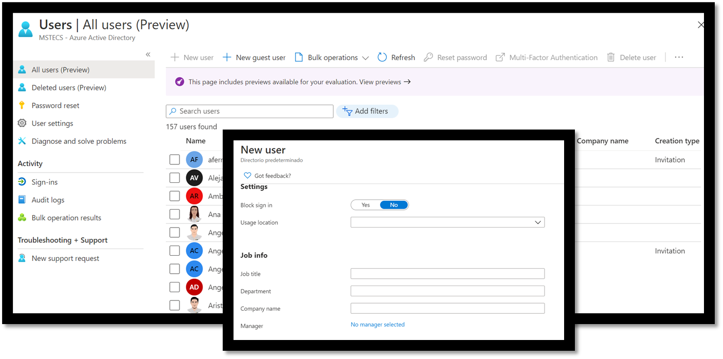
Creating New Users

Slide 10
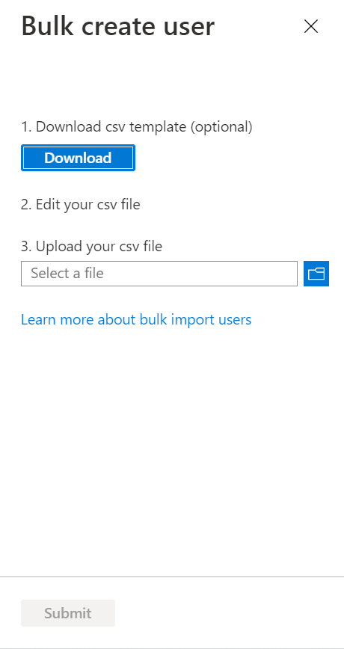
Bulk Operations with Users
Using the CSV file:
Use Connect-AzAccount to create a PowerShell connection
Create a new Password Profile for the new users.
Use Import-CSV to import the CSV file.
Loop through the users in the file constructing the user parameters required per user.
Use New-AzADUser to create each user. Be sure to enable each account.

Slide 11
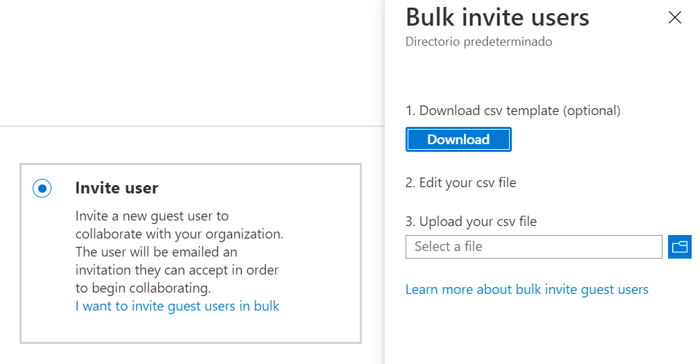
Guest Accounts
For users that exist outside Azure:
Examples include accounts from other cloud providers and Microsoft accounts such as an Xbox LIVE account.
Their source is Invited user. This type of account is useful when external vendors or contractors need access to Azure resources.
Once external vendor help is no longer necessary, the account can be removed along with external access.

Slide 12
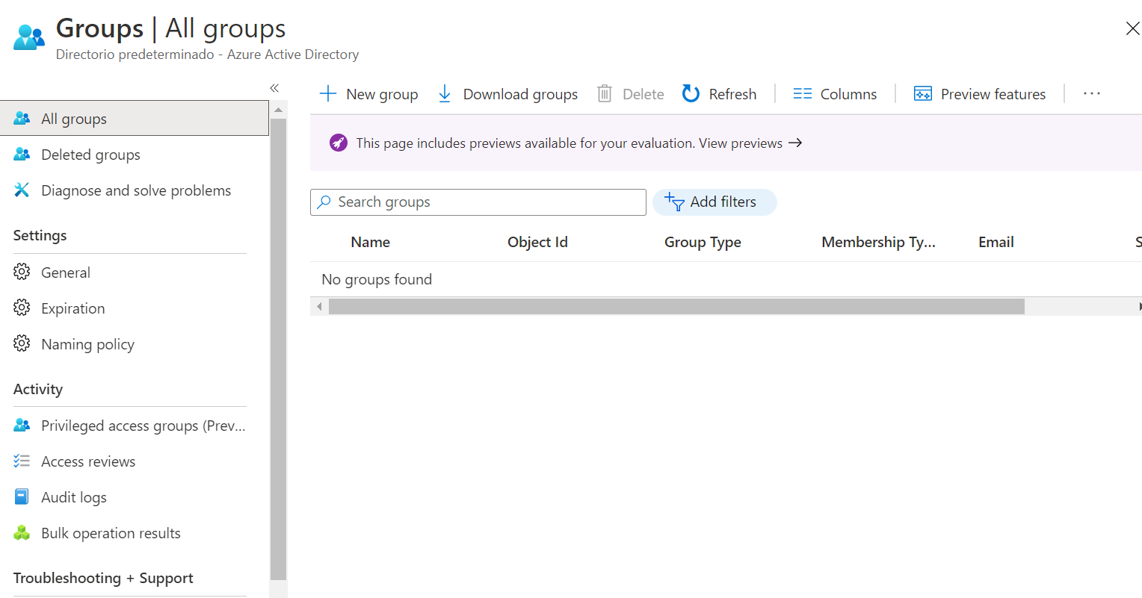
Creating and Managing Groups and Users
Azure AD allows one to define two different types of groups:
Security Groups: Used to manage member and computer access to shared resources for a group of users.
Microsoft 365 Groups: These groups provides access to a shared mailbox, calendar, files, SharePoint site, and more.

Slide 13
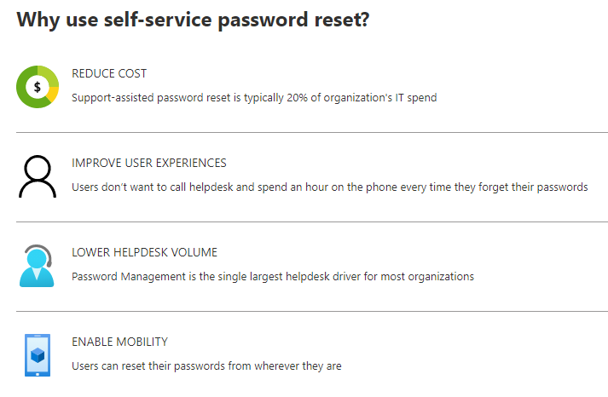
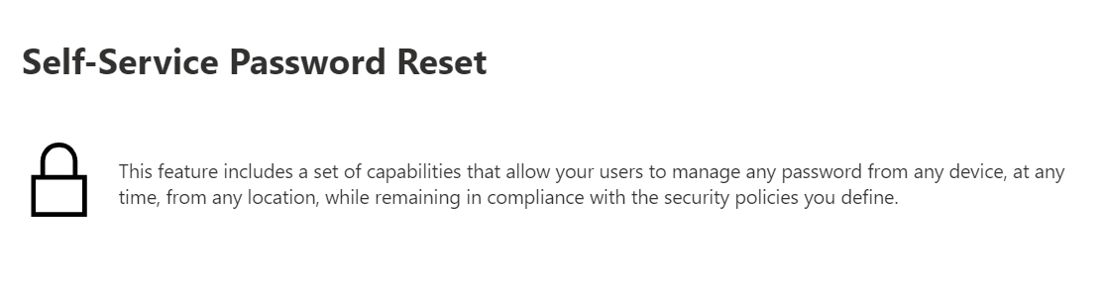
Self-Service Password Reset

Slide 14
Lesson 2 – Working with Role-Based Access Control (RBAC)

Slide 15
Role-Based Access Control (RBAC)
Azure Custom Role-Based Access Control is an authorization system for the Azure Resource Manager that provides access management to all Azure resources.
User
Role
Rights

Slide 16

RBAC Authentication
RBAC includes many built-in roles and can be assigned at different scopes. It allows creation of custom roles.
To manage resources in Azure AD, such as users, groups, and domains, there are several Azure AD administrator roles.​
​This diagram is a high-level view of how the Azure RBAC roles and Azure AD administrator roles are related.
Azure AD Admin Roles
Azure AD Tenant
Global Admin
/ Root
Azure RBAC Roles
Root
Management Group
Account Admin
Classic Subscription
Admin Roles
Azure Account

Slide 17
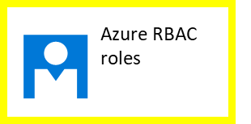
RBAC Concepts
Security Principal: Object that represents something that is requesting access to resources​.
Role Definition: Collection of permissions that lists the operations that can be performed​.
Scope: Boundary for the level of access that is requested​.
Assignment. Attaching a role definition to a security principal at a particular scope​.

Slide 18
Set Appropriate Roles
Built-in Role | Description
Contributor | Manages everything except granting access to resources.
Owner | Manages everything, including access to resources.
Reader | Can view everything, but not make any changes.
User Access Administrator | Manage user access to Azure resources.

Slide 19
Differences Between Azure RBAC Roles and Azure AD Roles
Azure RBAC Roles | Azure AD Roles
Manage access to Azure resources. | Manage access to Azure Active Directory resources.
Scope can be specified at multiple levels (management group, subscription, resource group, resource). | Scope is at the tenant level.
Role information can be accessed in Azure portal, Azure CLI, Azure PowerShell, Azure Resource Manager templates, and REST API. | Role information can be accessed in Azure admin portal, Microsoft 365 admin portal, Microsoft Graph AzureAD PowerShell.

Slide 20
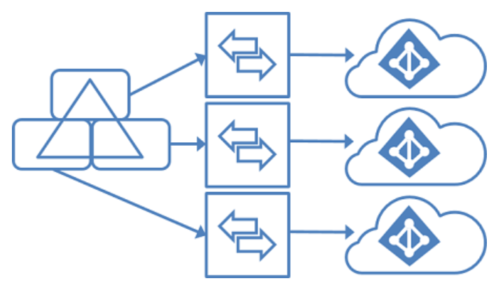
Manage Multiple Directories
Each tenant is a fully independent resource: a peer that is logically independent from the other tenants that users manage.
Resource Independence
Administrative Independence
Synchronization Independence

Slide 21
Lesson 3 – Managing Subscriptions & Governance

Slide 22
Azure Subscription
Azure Subscriptions:
Logical Unit of Azure Services
Linked to an Azure Account
Basis for Azure Services
Helps Users Organize Access to Cloud Service Resources
Helps Users Control How Resource Usage is Reported, Billed, and Paid for
Manage Every Cloud Service
Required for Programmatic Operations in Azure

Slide 23
Management Groups
Azure Management Groups Provide a Level of Scope Above Subscriptions
Targeting of Policies and Spend Budgets Across Subscriptions May be Organized and Inherited Down the Hierarchies.
Compliance and Cost Reporting by Organization or Business Units
Management Groups Enable Organizational Alignment for Azure Subscriptions through Custom Hierarchies and Grouping

Slide 24
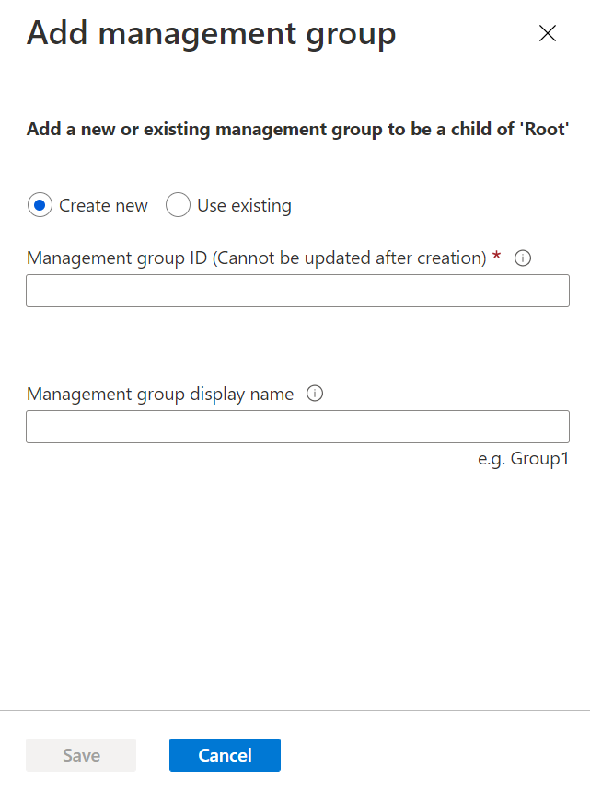
Create Management Groups
Using management groups helps organizations manage access, policy, and compliance by grouping multiple subscriptions together.
Organize subscriptions into groups called "management groups" to help manage access, policy and compliance across subscriptions. Management groups give enterprise-grade management at a large scale no matter what type of subscriptions an organization may have.

Slide 25
Hierarchy of Management Groups and Subscriptions
Management Group
Subscription
Resource Group

Slide 26
Ways to Get an Azure Subscription
Enterprise Agreements
Reseller
Partners
Personal Free Account

Slide 27
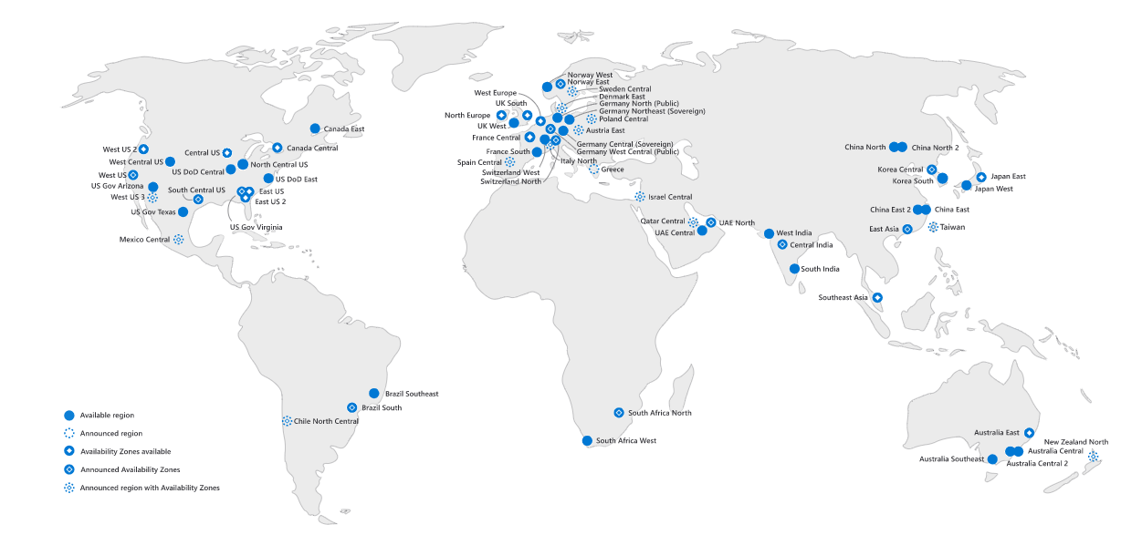
Region
In Azure, a Region is a geographical area on the planet containing at least one, but potentially multiple, datacenters that are in close proximity and networked together with a low-latency network.

Slide 28
Azure Accounts
Subscriptions have accounts. An Azure account is simply an identity in Azure Active Directory (Azure AD) or in a directory that is trusted by Azure AD, such as a work or school organization.
If users don't belong to one of these organizations, they can sign up for an Azure account by using their Microsoft Account, which is also trusted by Azure AD.

Slide 29

Resource and Subscription Permissions
Important considerations between Subscription and Azure AD:
Azure Subscription has a trust relationship with Azure AD.
Multiple subscriptions can trust the same Azure AD.
Each subscription can only trust a single directory.
If the subscription expires, the security principals lose access.
N:1
Subscription
Azure AD

Slide 30
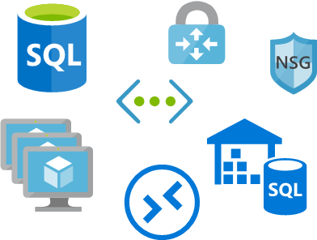
Resource and Subscription Permissions
Azure Portal
Azure PowerShell
Azure CLI
REST Clients
SDKs
Azure Resource Manager
Authentication
Azure Resource Manager Role - Handles Azure Requests

Slide 31
Azure Policies
The Azure Policy helps to enforce organizational standards and assess compliance at-scale. The main advantages of Azure policy are:
Enforcement and Compliance
Apply Policies at Scale
Remediation

Slide 32
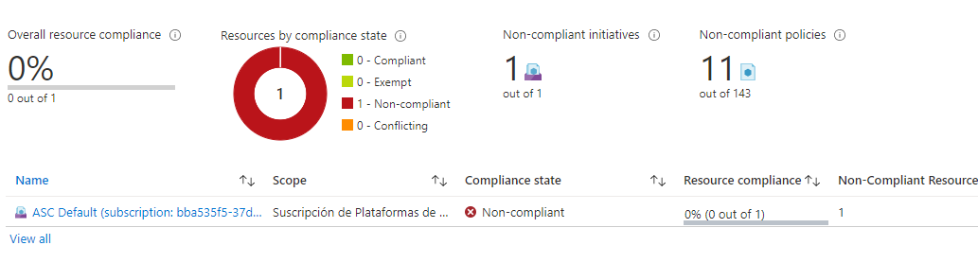
Azure Policies
Cases to Use Policies
Specify the resource types that the organization can deploy.
Specify a set of Virtual Machine SKUs that the organization can deploy.
Restrict the locations the organization can specify when deploying resources.
Enforce a required tag and its value.
Audit if Azure Backup service is enabled for all Virtual Machines.

Slide 33
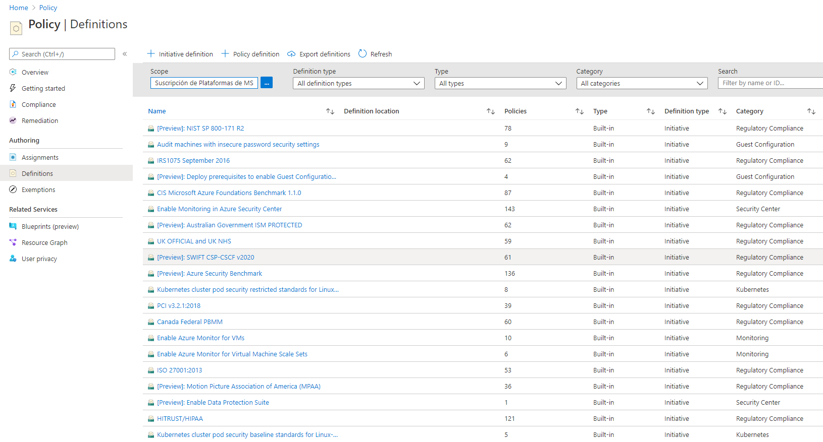
Policy Definitions
There are many Built-In Policy Definitions for users to choose from. Sorting by Category will help users locate what they need.

Slide 34
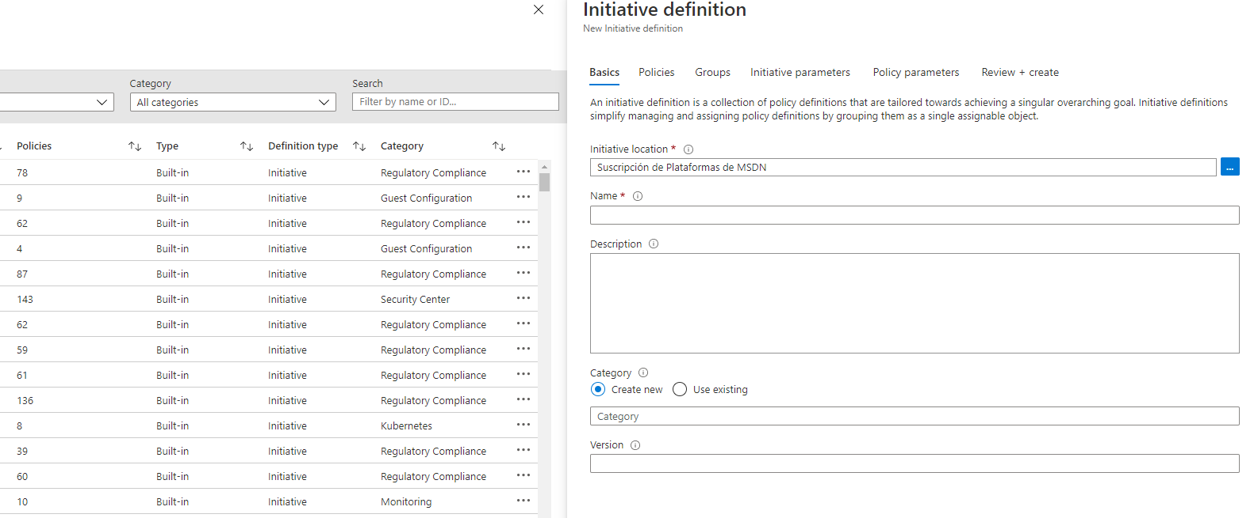
Initiative Definitions
Initiative Definition will include one or more policies. There is a pick list on the right side of the New Initiative Definition page to assist in making a selection.

Slide 35
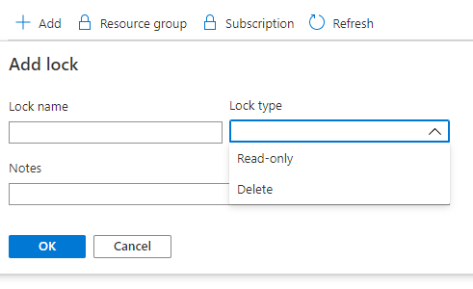
Resource Locks
Resource manager locks allow organizations to put a structure in place that prevents the accidental deletion of resources in Azure. There are two types of resource locks:
Read-Only Locks: which prevent any changes to the resource.
Delete Locks: which prevent deletion.

Slide 36
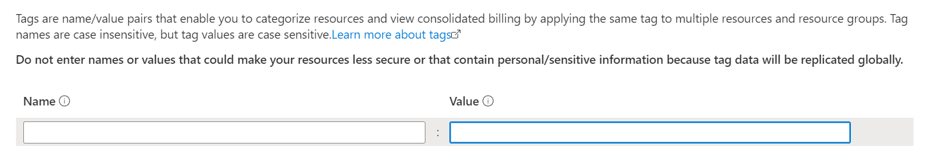
Tags
Tags in Azure may be applied to logically organize resources by categories. Each tag consists of a name and a value.

Slide 37
Tags
Use PowerShell or the CLI.
To create a lot of tags, users can do this programmatically.
Tags applied to the resource group are not inherited by the resources in that resource group.
Each resource or resource group can have a maximum of 50 tag names/value pairs.
One of the best uses of tags is to group billing data.
When users download the usage CSV for services, the tags appear in the Tags column.
Users can then group virtual machines by cost center and production environment.

Slide 38
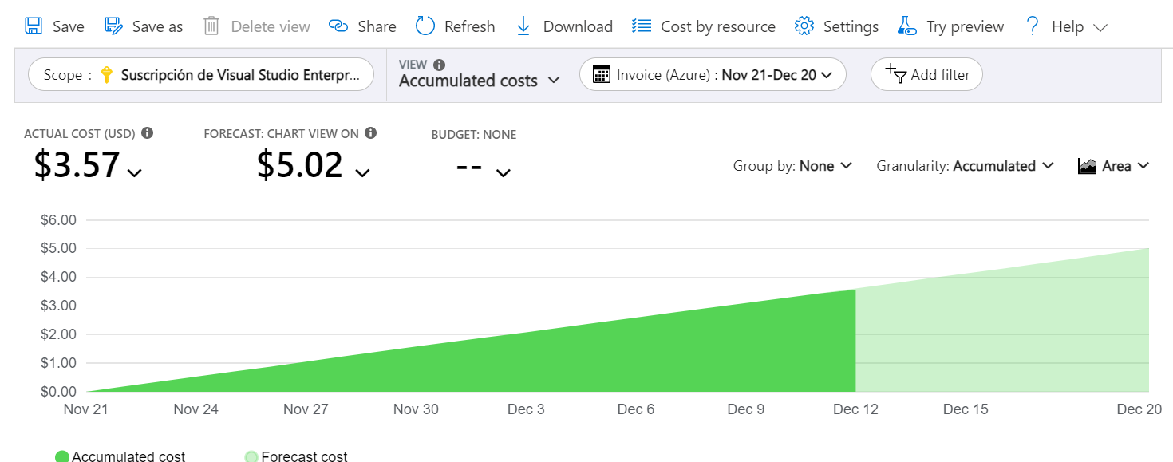
Cost Management
Use Azure Cost Management and Billing features to conduct administrative billing tasks and manage billing access to costs.
Cost Management can help users plan for and control their costs through:
Cost Analysis
Budgets
Recommendations
Exporting Cost Management Data

Slide 39
Plan and Control Expenses
Cost Analysis:
Explore and analyze organizational costs.
View aggregated costs by organization.
See accumulated costs over time.
Cost trends against a budget.
Exporting Cost Management Data:
Users can easily export the data from Azure.
Set a daily scheduled export in CSV format.
Store the data files in Azure storage.
Budgets:
Plan for and address financial accountability in the organization.
Help prevent cost thresholds or limits from being surpassed.
Inform others about their spending to proactively manage costs.
See how spending progresses over time.
Recommendations:
Show how to optimize and improve efficiency.
Identifying idle and underutilized resources.
Show less expensive resource options.

